Slide 1

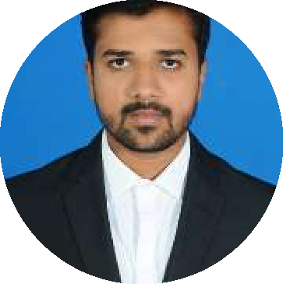





Kushal Hiremath
Education and certificates Bachelor of Technlogy, Information Science and Engineering : 2014 - 2019
Skills
Analyst/Software Engineer
Base Location: Bangalore
Email ID: Kushal.hiremath@capgemini.com
Mobile No: +916363073121
Grade: A4
C# | C# Basics,OOPS,Generics, Collections, Array,Loops,LINQ
.NET | ADO.NET,ASP.NET with MVC5 and WEB API,Entity Framework
React | Components, Hooks, Virtual DOM, Routing, Forms & Validation
Database | Microsoft SQL Server
UI Tech | HTML 5 & CSS 3,JavaScript, ES6 & TypeScript ,Optimized UI Design
Cloud | Microsoft Azure training ongoing
Tools | Git, PostMan,SSMS,Visual Stu dio, Visual Studio Code
Add On skills | Immersive Learning and Java
Strengths
Full Stack Developer
Hands on experience on C#,ADO.NET,LINQ, Entityframework, SqlServer, ASP.NET MVC5 with WEB API
Proficient in creating Single page Web Application in React with Authentication with routing
Hands on experience in developing web pages using HTML5, CSS, Object TypeScript, Good understanding of Document Object Model (DOM) and DOM Functions
Ready to learn new technologies and implement them for the Future Knowledge improvement.
Achievement
Online Railway Reservation System
Profile]
[ Video
Case study of Online Railway Reservation System along with API Gateway, Swagger, responsive UI with HTML5, CSS, Bootstrap and React used as User Interface.
Degreed :Successfully completed the degreed training in git, html, CSS, SQL, C#, .NET Core, React.
Check out my work on GitHub
Presentation Title | Author | Date © Capgemini 2017. All rights reserved | 1

